Slide 1
Few-Shot Learning
Presented by Michael Bikman “Image Classification Seminar” Haifa University, Spring 2021
Based on “Prototypical Networks for Few-shot Learning” Jake Snell, Kevin Swersky, Richard S. Zeme 2017

Slide 2
Problem Introduction
Humans can recognize new object classes from very few instances.
However, ML often requires thousands of examples to achieve similar or close performance.
Extreme case – only one single example per class
“One-shot-learning”
Covered in the previous lecture

Slide 3
Few Shot Learning
Classification of new data having seen only few training examples
Computers are expected to learn from few examples like humans
Practically, Few-Shot Learning is useful:
when training examples are hard to find
e.g. images of rare bird species or cases of rare disease
when data labeling / collection cost is high
with a huge dataset, correctly labelling can be costly
Requires less data to train a model
less training data means low dimensionality in the training dataset, which can significantly reduce the computational costs

Slide 4
Definitions

Slide 5
N-way-K-shot classification
N = the number of classes
K = the number of samples from each class to train on
Typical example: 20-way-5-shot
Conventional training methods cannot be used
classification algorithm will depend on far more parameters than there are training examples
will generalize poorly (highly overfitting)

Slide 6


Idea: Meta-Learning Problem
Train set
Classical approach
Learn from training set
Evaluate results on a test set
Test set

Slide 7
Idea: Meta-Learning Problem
Train set
Classical approach
Learn from training set
Evaluate results on a test set
Overfits heavily!
Not enough data for classical algorithms
Test set

Slide 8
Idea: Meta-Learning Problem
Train set
Classical approach
Learn from training set
Evaluate results on a test set
Overfits heavily!
Meta-Learning approach
learn how to learn
Not enough data for classical algorithms
Test set

Slide 9
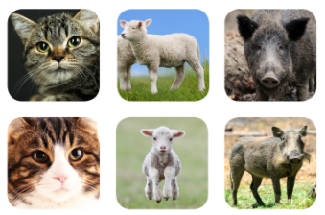



Meta-Learning – Example (3-way-2-shot)
Learn given a set of training tasks, evaluate using a set of test tasks
Use set of classification problems to help solve other unrelated sets
Train task 1
Train task 2
Test task
Support set
Support set
Support set
Query set
Query set
Query set
Images from: https://www.borealisai.com/en/blog/tutorial-2-few-shot-learning-and-meta-learning-i

Slide 10
Meta-Learning – Example (3-way-2-shot)
Train tasks are sampled from the base dataset
choosing a base-dataset is crucial (have to pick a good one!)
sampled mini-batches called episodes
Train episode 1
Train episode 2
Test task
Support set
Support set
Support set
Query set
Query set
Query set
Images from: https://www.borealisai.com/en/blog/tutorial-2-few-shot-learning-and-meta-learning-i

Slide 11
Meta-Learning – Example (3-way-2-shot)
Each episode is designed to mimic the few-shot task
same N and K parameters
Train episode 1
Train episode 2
Test task
3-way-2-shot
Support set
3-way-2-shot
Support set
3-way-2-shot
Support set
Query set
Query set
Query set
Images from: https://www.borealisai.com/en/blog/tutorial-2-few-shot-learning-and-meta-learning-i

Slide 12
Meta-Learning – Example (3-way-2-shot)
Episodes makes the training problem more faithful to the test environment
improves generalization: the key issue in FSL is overfitting – so let’s fight it!
Train episode 1
Train episode 2
Test task
Support set
Support set
Support set
Query set
Query set
Query set
Images from: https://www.borealisai.com/en/blog/tutorial-2-few-shot-learning-and-meta-learning-i

Slide 13
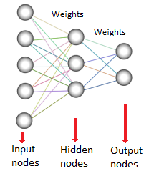
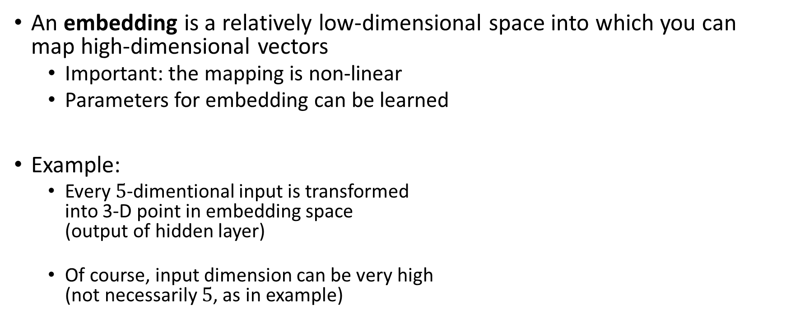
Important definition - embedding
An embedding is a relatively low-dimensional space into which you can map high-dimensional vectors
Important: the mapping is non-linear
Parameters for embedding can be learned
Example:
Every $5$-dimentional input is transformed into 3-D point in embedding space (output of hidden layer)
Of course, input dimension can be very high (not necessarily $5$, as in example)

Slide 14
Prototypical learning networks

Slide 15
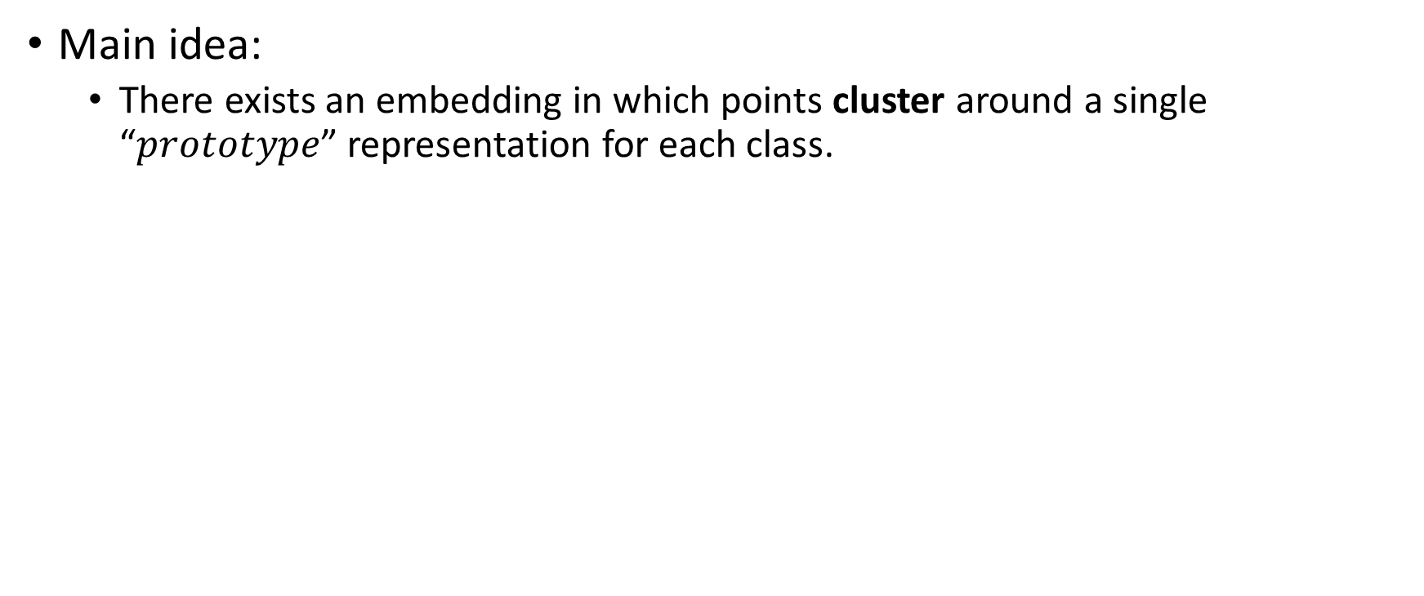
Prototypical learning networks – General Idea
Main idea:
There exists an embedding in which points cluster around a single “$prototype$” representation for each class.
Not separable data
Input space

Slide 16
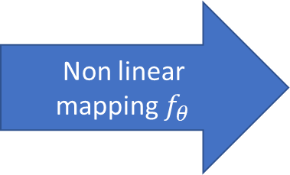
Prototypical learning networks – General Idea
Main idea:
There exists an embedding in which points cluster around a single “$prototype$” representation for each class.
Not separable data
Clustered data
Non linear mapping $f_{θ}$
Input space
Embedding space

Slide 17
Prototypical learning networks – General Idea
Learning:
Let’s learn the non-linear mapping of the inputs into an embedding space.
Calculate the prototype coordinates (mean of the support set points)
Not separable data
Clusters + Prototypes
Non linear mapping $f_{θ}$
Input space
Embedding space

Slide 18
Prototypical learning networks – General Idea
Classification:
Map the query input point to an embedding space
Find the closest prototype
Not separable data
Clusters + Prototypes
Non linear mapping $f_{θ}$
Input space
Embedding space

Slide 19
Training Algorithm

Slide 20
Prototypical Networks – Training flow
Learn example: 4-way-3-shot
build episode, calculate loss per training episode, and learn
Dataset - all classes
Dog
Choose 4 classes
Choose 3 examples from each class
Choose 2 other examples from each class
Calculate prototype
Calculate loss
Cat
…
Episode classes
Support set
Query set
Bug
Learn embedding parameters

Slide 21
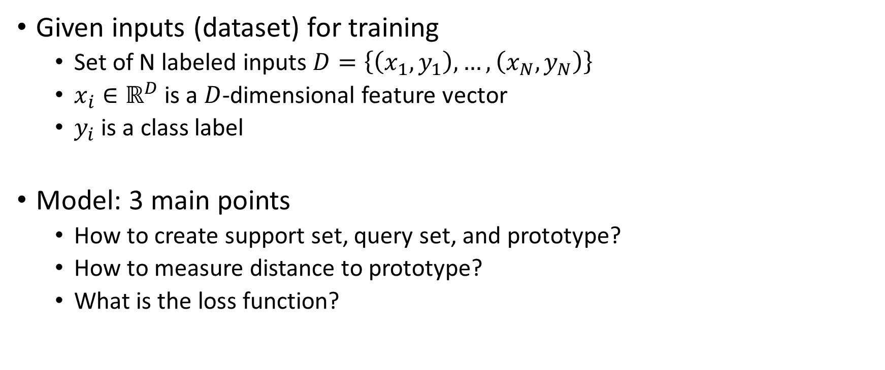
Prototypical Networks - Training
Given inputs (dataset) for training
Set of N labeled inputs $D=\left\{\left(x_{1},y_{1}\right),…,\left(x_{N},y_{N}\right)\right\}$
$x_{i}∈ℝ^{D}$ is a $D$-dimensional feature vector
$y_{i}$ is a class label
Model: 3 main points
How to create support set, query set, and prototype?
How to measure distance to prototype?
What is the loss function?

Slide 22
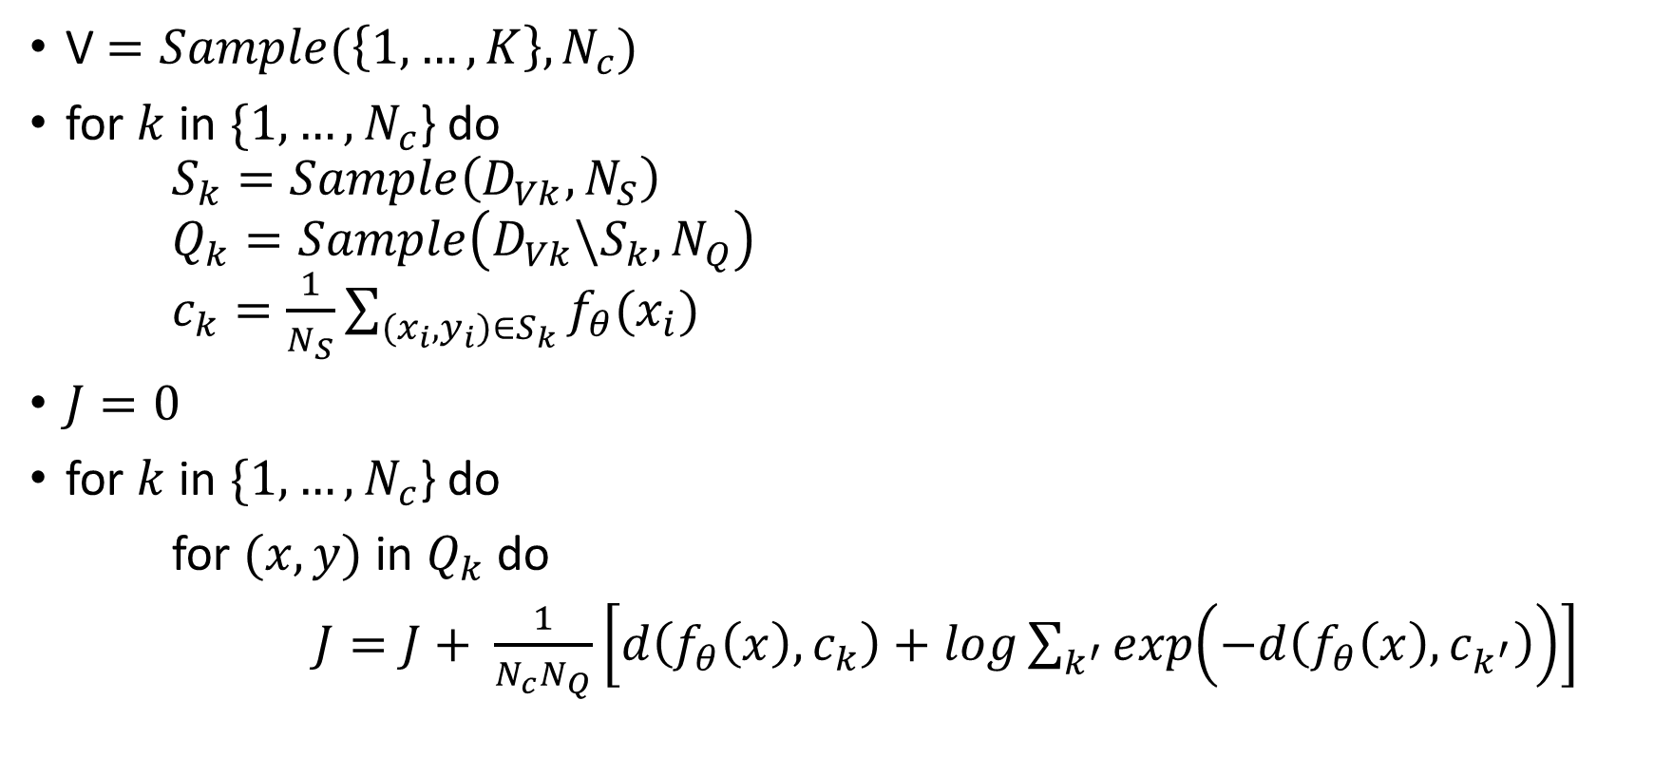
Algorithm for episode build & learning
V $=Sample(\left\{1,…,K\right\},N_{c})$
for $k$ in $\{1,…,N_{c}$} do $S_{k}=Sample\left(D_{Vk}, N_{S}\right)$ $Q_{k}=Sample\left(D_{Vk}\backslash S_{k},N_{Q}\right)$ $c_{k}=\frac{1}{N_{S}}\sum_{(x_{i},y_{i})∈S_{k}}{f_{θ}(x_{i})}$
$J=0$
for $k$ in $\{1,…,N_{c}$} do
for $(x,y)$ in $Q_{k}$ do
$J=J+ \frac{1}{N_{c}N_{Q}}\left[d\left(f_{θ}\left(x\right),c_{k}\right)+log\sum_{k^{′}}{exp\left(−d\left(f_{θ}\left(x\right),c_{k^{′}}\right)\right)}\right]$
$N_{c}$ = number of classes in episode
$S_{k}$ = set of support examples of class $k$
$N_{s}$ = number of support examples per class
$Q_{k}$ = set of query examples of class $k$
$N_{Q}$ = number of query examples per class
$D_{Vk}$= set of all inputs of class $k$
$J$ = loss function

Slide 23
Prototypical Networks – Algorithm – 2 parts
V $=Sample(\left\{1,…,K\right\},N_{c})$
for $k$ in $\{1,…,N_{c}$} do $S_{k}=Sample\left(D_{Vk}, N_{S}\right)$ $Q_{k}=Sample\left(D_{Vk}\backslash S_{k},N_{Q}\right)$ $c_{k}=\frac{1}{N_{S}}\sum_{(x_{i},y_{i})∈S_{k}}{f_{θ}(x_{i})}$
$J=0$
for $k$ in $\{1,…,N_{c}$} do
for $(x,y)$ in $Q_{k}$ do
$J=J+ \frac{1}{N_{c}N_{Q}}\left[d\left(f_{θ}\left(x\right),c_{k}\right)+log\sum_{k^{′}}{exp\left(−d\left(f_{θ}\left(x\right),c_{k^{′}}\right)\right)}\right]$
$N_{c}$ = number of classes in episode
$S_{k}$ = set of support examples of class $k$
$N_{s}$ = number of support examples per class
$Q_{k}$ = set of query examples of class $k$
$N_{Q}$ = number of query examples per class
$D_{Vk}$= set of all inputs of class $k$
$J$ = loss function
Choose support and query sets, and create prototype
Calculate loss and learn parameter

Slide 24
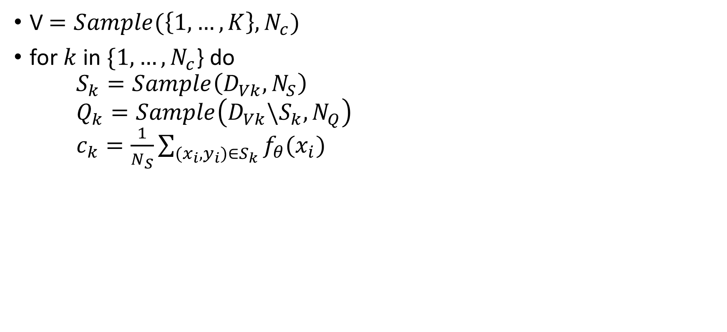
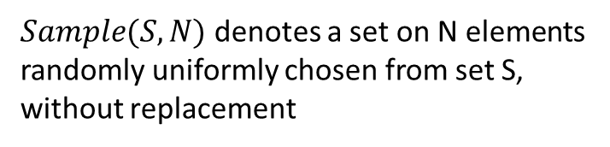
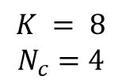
Alg. Explanation, 1st part – 4-way-3-shot
V $=Sample(\left\{1,…,K\right\},N_{c})$
for $k$ in $\{1,…,N_{c}$} do $S_{k}=Sample\left(D_{Vk}, N_{S}\right)$ $Q_{k}=Sample\left(D_{Vk}\backslash S_{k},N_{Q}\right)$ $c_{k}=\frac{1}{N_{S}}\sum_{(x_{i},y_{i})∈S_{k}}{f_{θ}(x_{i})}$
$N_{c}$ = number of classes in episode
$S_{k}$ = set of support examples of class $k$
$N_{s}$ = number of support examples per class
$Q_{k}$ = set of query examples of class $k$
$N_{Q}$ = number of query examples per class
$D_{Vk}$= set of all inputs of class $k$
$Sample(S,N)$ denotes a set on N elements randomly uniformly chosen from set S, without replacement
Select classes (indices) for the episode:
Cat
Dog
Goose
Shark
Pig
Ant
Owl
Hamster
Cat
Dog
Pig
Ant
$$K = 8$$
$$N_{c}=4$$
Choose 4

Slide 25



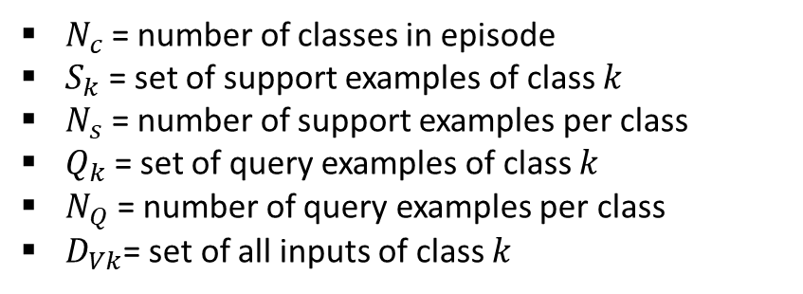
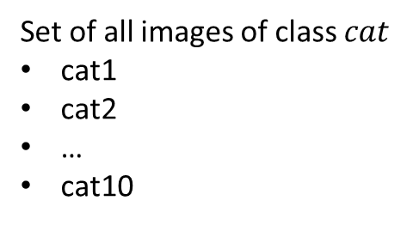
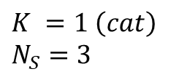
Alg. Explanation, 1st part – 4-way-3-shot
V $=Sample(\left\{1,…,K\right\},N_{c})$
for $k$ in $\{1,…,N_{c}$} do $S_{k}=Sample\left(D_{Vk}, N_{S}\right)$ $Q_{k}=Sample\left(D_{Vk}\backslash S_{k},N_{Q}\right)$ $c_{k}=\frac{1}{N_{S}}\sum_{(x_{i},y_{i})∈S_{k}}{f_{θ}(x_{i})}$
$N_{c}$ = number of classes in episode
$S_{k}$ = set of support examples of class $k$
$N_{s}$ = number of support examples per class
$Q_{k}$ = set of query examples of class $k$
$N_{Q}$ = number of query examples per class
$D_{Vk}$= set of all inputs of class $k$
Select support examples:
Cat
Dog
Pig
Ant
Set of all images of class $cat$
cat1
cat2
…
cat10
Set of support examples
cat2
cat8
cat9
$$K =1 \left(cat\right)$$
$$N_{S}=3$$
Choose 3

Slide 26
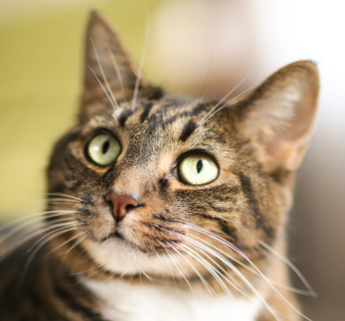

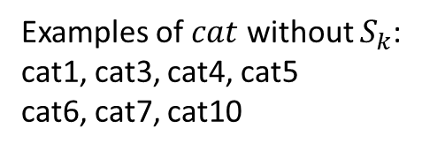
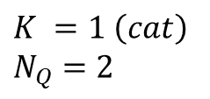
Alg. Explanation, 1st part – 4-way-3-shot
V $=Sample(\left\{1,…,K\right\},N_{c})$
for $k$ in $\{1,…,N_{c}$} do $S_{k}=Sample\left(D_{Vk}, N_{S}\right)$ $Q_{k}=Sample\left(D_{Vk}\backslash S_{k},N_{Q}\right)$ $c_{k}=\frac{1}{N_{S}}\sum_{(x_{i},y_{i})∈S_{k}}{f_{θ}(x_{i})}$
$N_{c}$ = number of classes in episode
$S_{k}$ = set of support examples of class $k$
$N_{s}$ = number of support examples per class
$Q_{k}$ = set of query examples of class $k$
$N_{Q}$ = number of query examples per class
$D_{Vk}$= set of all inputs of class $k$
Select query examples:
Cat
Dog
Pig
Ant
Examples of $cat$ without $S_{k}$:
cat1, cat3, cat4, cat5 cat6, cat7, cat10
Set of query examples
cat3
cat5
$$K =1 \left(cat\right)$$
$$N_{Q}=2$$
Choose 2

Slide 27




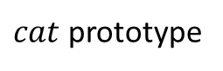
Alg. Explanation, 1st part – 4-way-3-shot
V $=Sample(\left\{1,…,K\right\},N_{c})$
for $k$ in $\{1,…,N_{c}$} do $S_{k}=Sample\left(D_{Vk}, N_{S}\right)$ $Q_{k}=Sample\left(D_{Vk}\backslash S_{k},N_{Q}\right)$ $c_{k}=\frac{1}{N_{S}}\sum_{(x_{i},y_{i})∈S_{k}}{f_{θ}(x_{i})}$
$N_{c}$ = number of classes in episode
$S_{k}$ = set of support examples of class $k$
$N_{s}$ = number of support examples per class
$Q_{k}$ = set of query examples of class $k$
$N_{Q}$ = number of query examples per class
$D_{Vk}$= set of all inputs of class $k$
Compute prototype from embeddings of support examples set.
Images are just for example (and fun)
Support set
Map to embedding space
Calculate mean vector
cat2
cat8
cat9
$cat$ prototype

Slide 28


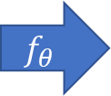
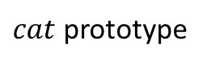
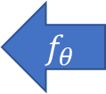
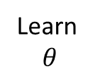
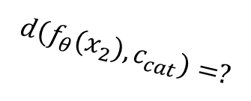
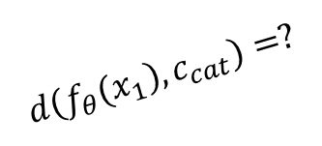
Alg. Explanation, 1st part – 4-way-3-shot
V $=Sample(\left\{1,…,K\right\},N_{c})$
for $k$ in $\{1,…,N_{c}$} do $S_{k}=Sample\left(D_{Vk}, N_{S}\right)$ $Q_{k}=Sample\left(D_{Vk}\backslash S_{k},N_{Q}\right)$ $c_{k}=\frac{1}{N_{S}}\sum_{(x_{i},y_{i})∈S_{k}}{f_{θ}(x_{i})}$
$N_{c}$ = number of classes in episode
$S_{k}$ = set of support examples of class $k$
$N_{s}$ = number of support examples per class
$Q_{k}$ = set of query examples of class $k$
$N_{Q}$ = number of query examples per class
$D_{Vk}$= set of all inputs of class $k$
$$d\left(f_{θ}(x_{1}\right), c_{cat})=?$$
Calculate Loss
$$f_{θ}$$
Mean
$$f_{θ}$$
Learn $$θ$$
$cat$ prototype
$$d\left(f_{θ}(x_{2}\right), c_{cat})=?$$
Support set
Query set

Slide 29
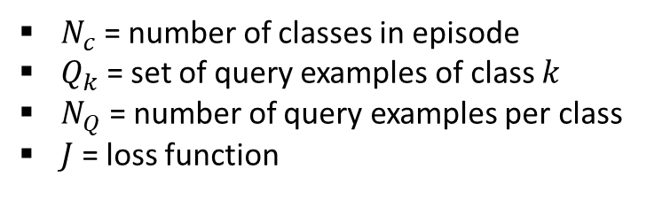
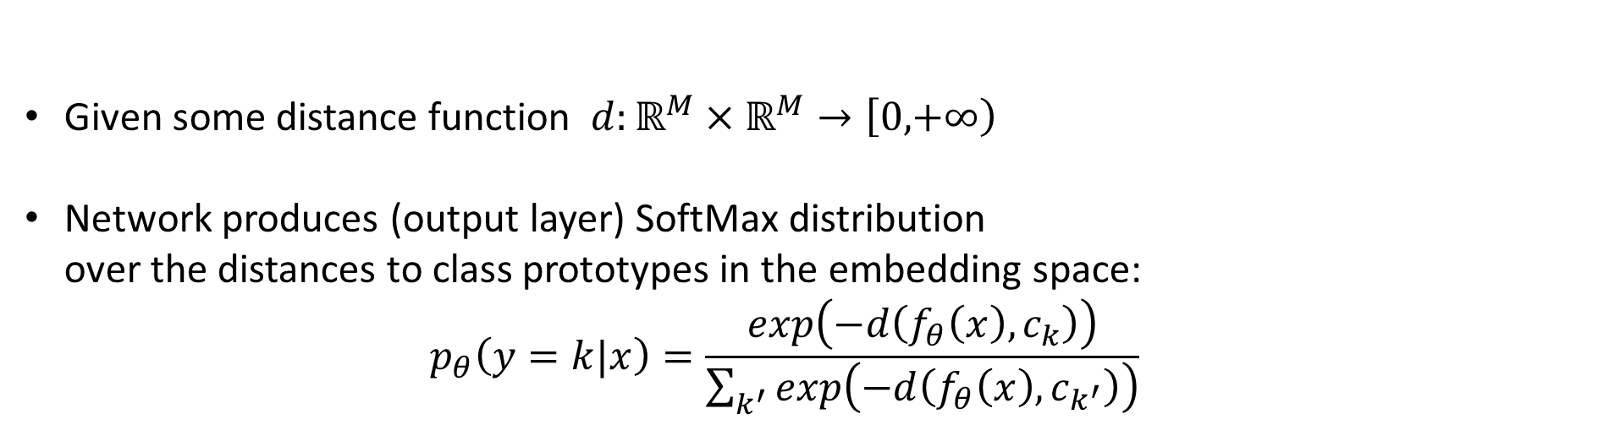
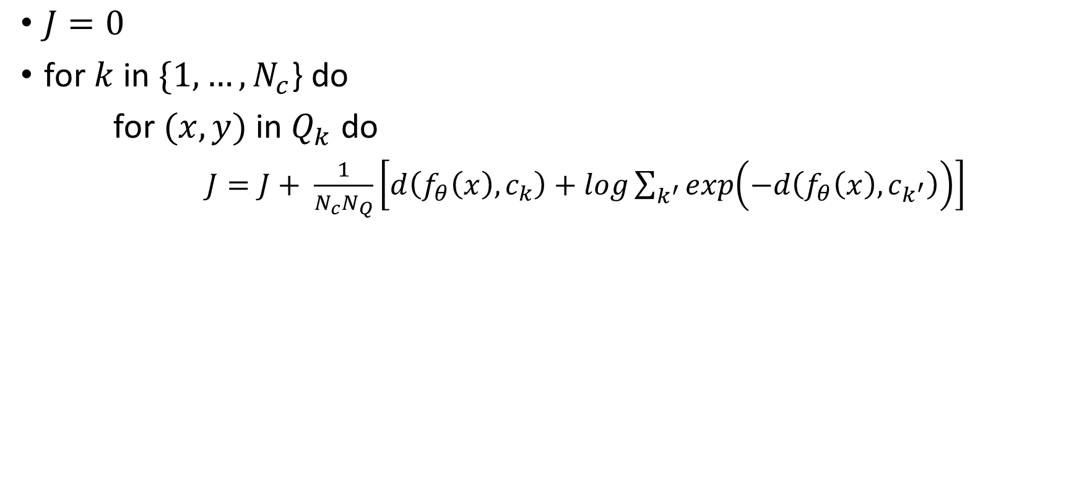
Alg. Explanation, 2nd part – Loss & Learn
$N_{c}$ = number of classes in episode
$Q_{k}$ = set of query examples of class $k$
$N_{Q}$ = number of query examples per class
$J$ = loss function
$J=0$
for $k$ in $\{1,…,N_{c}$} do
for $(x,y)$ in $Q_{k}$ do
$J=J+ \frac{1}{N_{c}N_{Q}}\left[d\left(f_{θ}\left(x\right),c_{k}\right)+log\sum_{k^{′}}{exp\left(−d\left(f_{θ}\left(x\right),c_{k^{′}}\right)\right)}\right]$
Given some distance function $d:ℝ^{M}×ℝ^{M}→\left[0,\right.\left.+∞\right)$
Network produces (output layer) SoftMax distribution over the distances to class prototypes in the embedding space: $p_{θ}\left(y=k|x\right)=\frac{exp\left(−d\left(f_{θ}\left(x\right),c_{k}\right)\right)}{\sum_{k^{′}}{exp\left(−d\left(f_{θ}\left(x\right),c_{k^{′}}\right)\right)}}$

Slide 30
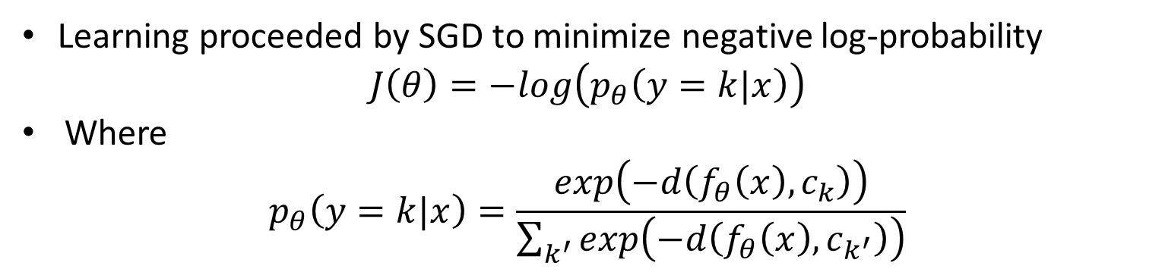
Alg. Explanation, 2nd part – Loss & Learn
$N_{c}$ = number of classes in episode
$Q_{k}$ = set of query examples of class $k$
$N_{Q}$ = number of query examples per class
$J$ = loss function
$J=0$
for $k$ in $\{1,…,N_{c}$} do
for $(x,y)$ in $Q_{k}$ do
$J=J+ \frac{1}{N_{c}N_{Q}}\left[d\left(f_{θ}\left(x\right),c_{k}\right)+log\sum_{k^{′}}{exp\left(−d\left(f_{θ}\left(x\right),c_{k^{′}}\right)\right)}\right]$
Learning proceeded by SGD to minimize negative log-probability
$$J\left(θ\right)=−log\left(p_{θ}\left(y=k|x\right)\right)$$
Where $p_{θ}\left(y=k|x\right)=\frac{exp\left(−d\left(f_{θ}\left(x\right),c_{k}\right)\right)}{\sum_{k^{′}}{exp\left(−d\left(f_{θ}\left(x\right),c_{k^{′}}\right)\right)}}$

Slide 31
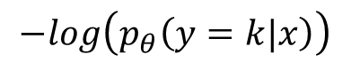
Alg. Explanation, 2nd part – Loss & Learn
$N_{c}$ = number of classes in episode
$Q_{k}$ = set of query examples of class $k$
$N_{Q}$ = number of query examples per class
$J$ = loss function
$J=0$
for $k$ in $\{1,…,N_{c}$} do
for $(x,y)$ in $Q_{k}$ do
$J=J+ \frac{1}{N_{c}N_{Q}}\left[d\left(f_{θ}\left(x\right),c_{k}\right)+log\sum_{k^{′}}{exp\left(−d\left(f_{θ}\left(x\right),c_{k^{′}}\right)\right)}\right]$
Learning proceeded by SGD to minimize negative log-probability
$$J\left(θ\right)=−log\left(p_{θ}\left(y=k|x\right)\right)$$
Where $p_{θ}\left(y=k|x\right)=\frac{exp\left(−d\left(f_{θ}\left(x\right),c_{k}\right)\right)}{\sum_{k^{′}}{exp\left(−d\left(f_{θ}\left(x\right),c_{k^{′}}\right)\right)}}$
$$−log\left(p_{θ}\left(y=k|x\right)\right)$$

Slide 32
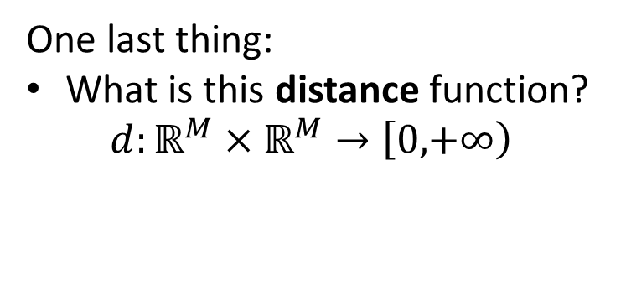
Prototypical Networks – Full Algorithm
V $=Sample(\left\{1,…,K\right\},N_{c})$
for $k$ in $\{1,…,N_{c}$} do $S_{k}=Sample\left(D_{Vk}, N_{S}\right)$ $Q_{k}=Sample\left(D_{Vk}\backslash S_{k},N_{Q}\right)$ $c_{k}=\frac{1}{N_{S}}\sum_{(x_{i},y_{i})∈S_{k}}{f_{θ}(x_{i})}$
$J=0$
for $k$ in $\{1,…,N_{c}$} do
for $(x,y)$ in $Q_{k}$ do
$J=J+ \frac{1}{N_{c}N_{Q}}\left[d\left(f_{θ}\left(x\right),c_{k}\right)+log\sum_{k^{′}}{exp\left(−d\left(f_{θ}\left(x\right),c_{k^{′}}\right)\right)}\right]$
$N_{c}$ = number of classes in episode
$S_{k}$ = set of support examples of class $k$
$N_{s}$ = number of support examples per class
$Q_{k}$ = set of query examples of class $k$
$N_{Q}$ = number of query examples per class
$D_{Vk}$= set of all inputs of class $k$
$J$ = loss function
One last thing:
What is this distance function? $d:ℝ^{M}×ℝ^{M}→\left[0,\right.\left.+∞\right)$

Slide 33
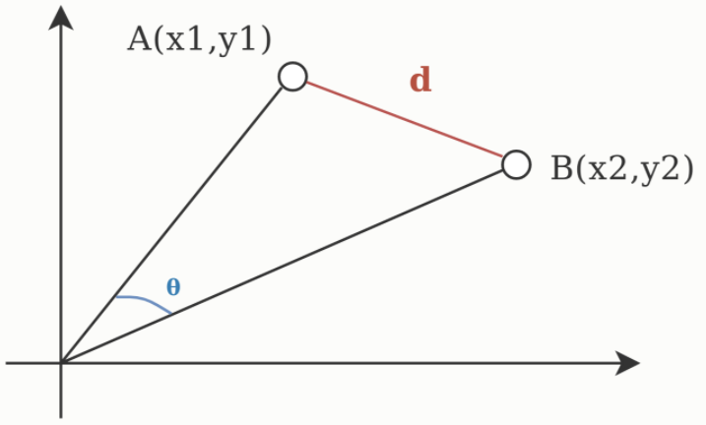
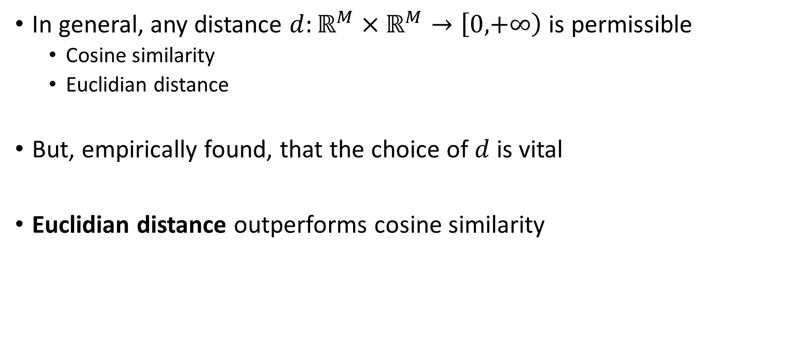
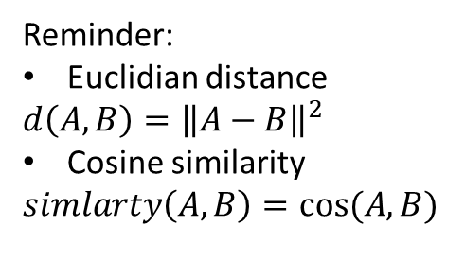
Prototypical Networks – Distance metric
In general, any distance $d:ℝ^{M}×ℝ^{M}→\left[0,\right.\left.+∞\right)$ is permissible
Cosine similarity
Euclidian distance
But, empirically found, that the choice of $d$ is vital
Euclidian distance outperforms cosine similarity
Reminder:
Euclidian distance
$$d\left(A,B\right)={\left\|A−B\right\|}^{2}$$
Cosine similarity
$$simlarty\left(A,B\right)=cos⁡(A,B)$$

Slide 34
Prototypical Networks – Distance metric
Euclidian distance outperforms cosine similarity
An elegant hypothetic explanation is given
Prototype computation yields optimal clustering for regular Bregman Divergences functions
Euclidian distance is in Bregman Divergences functions, while Cosine similarity is not
Please refer to the article for detailed analysis
Reminder:
Euclidian distance
$$d\left(A,B\right)={\left\|A−B\right\|}^{2}$$
Cosine similarity
$$simlarty\left(A,B\right)=cos⁡(A,B)$$

Slide 35
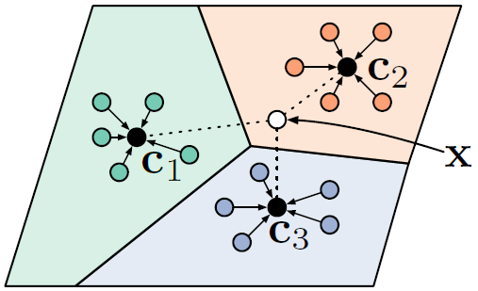
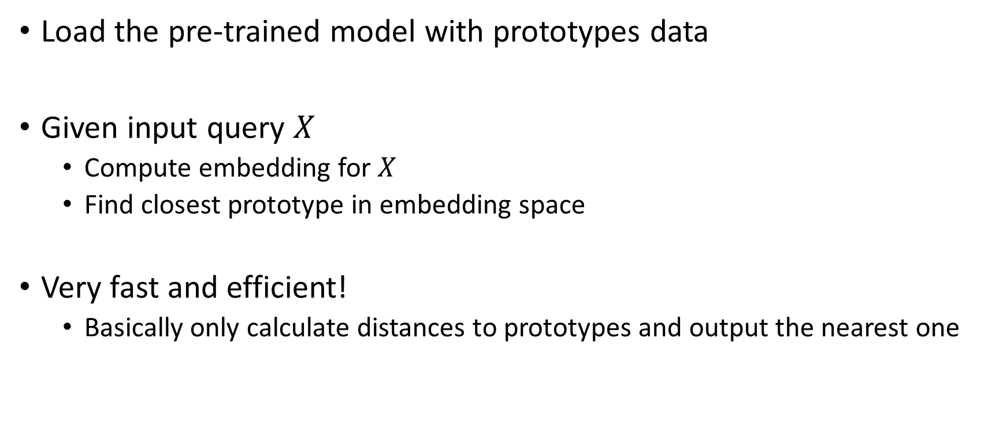
Prototypical Networks - Classification
Load the pre-trained model with prototypes data
Given input query $X$
Compute embedding for $X$
Find closest prototype in embedding space
Very fast and efficient!
Basically only calculate distances to prototypes and output the nearest one

Slide 36
Experiments & Results
+ Architecture explanation

Slide 37
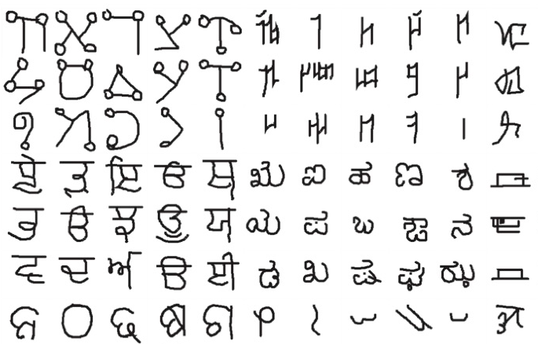
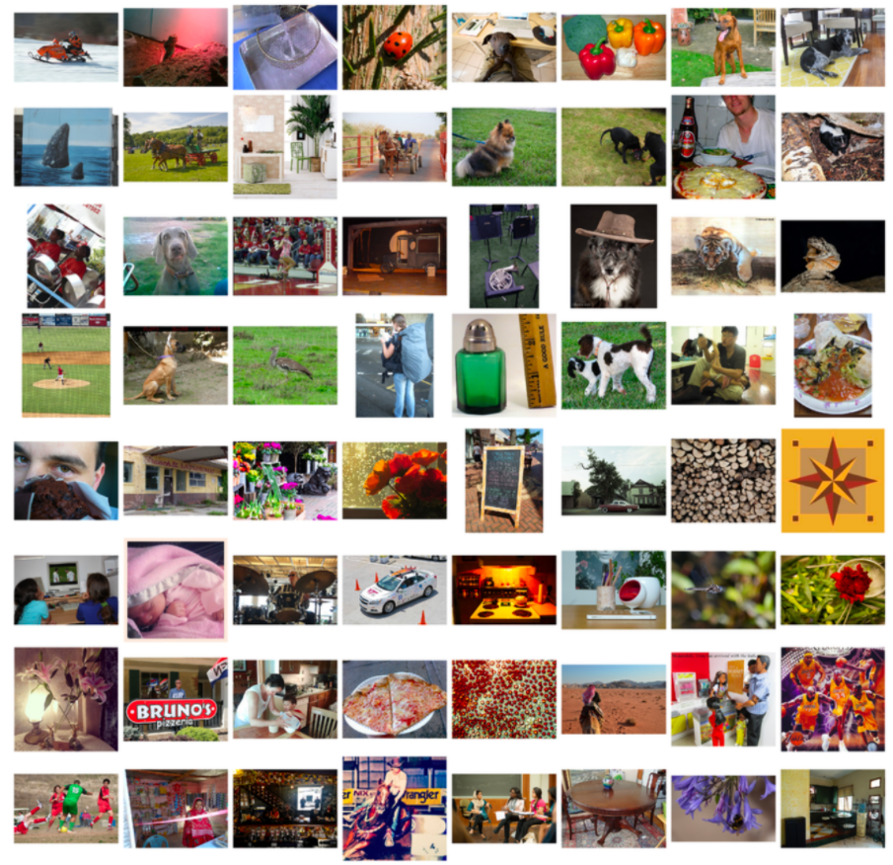
Experiments - FSL
Omniglot Few-Shot Learning
contains 1623 different handwritten characters from 50 different alphabets
20 examples per character
each example is drawn by a different human subject
Mini-Image Net Few-Shot Learning
Subset of ImageNet ILSVRC-2012 challenge set
Randomly chosen 600 images
Main rival – Matching Networks

Slide 38
Experiments – FSL Omniglot – CNN Arch.
Note: you can use any architecture you like
Flatten
14x14x64
7x7x64
3x3x64
1x1x64
28x28x3
CNN block
CNN block
CNN block
CNN block
64x1
image
Used by researchers:
4 CNN blocks are used
After all layers, output is flattened
Returns a vector of 64 dimensions at the end
a point in the embedding 64-D space
Per block:
CNN layer
Batch Normalization
ReLU activation
Max Pooling layer (2x2)

Slide 39
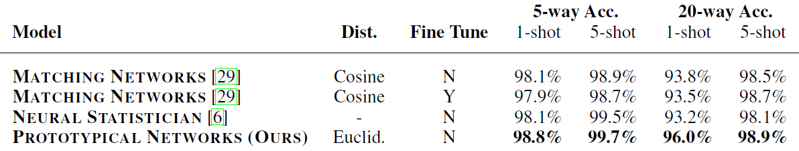

Experiments – FSL Omniglot - Results
Prototypical Networks FSL accuracies
compared against various baselines
represents the state-of-the-art on this dataset

Slide 40
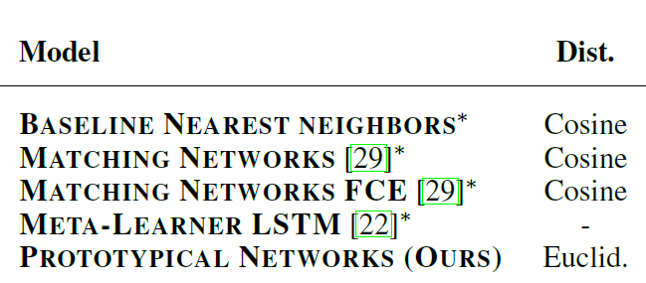
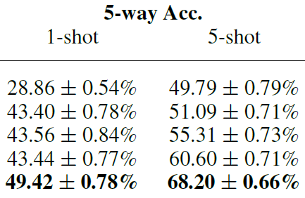
Experiments – FSL Mini-Image Net
same four-block embedding architecture as in Omniglot experiments
results in a 1600-dimensional output due to increased size of images
accuracy reported with 95% confidence intervals

Slide 41
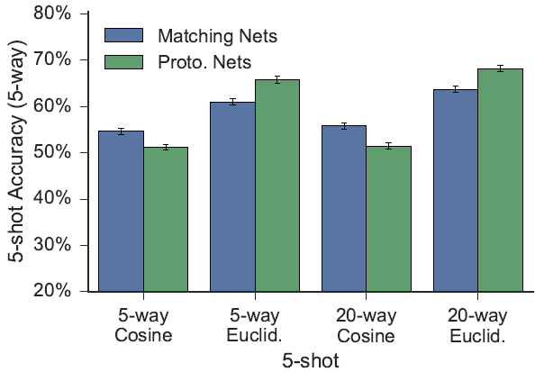
Experiments – FSL Mini-Image Net
Effect of distance metric and number of classes per training episode
Higher is better

Slide 42
Experiments – FSL Mini-Image Net
Effect of distance metric and number of classes per training episode
In general, Prototypical nets. perform better vs. Matching nets. with Euclidian distance

Slide 43
Conclusion
+ Future Work

Slide 44
Conclusion
Prototypical Networks is a promising approach for few-shot learning
Simple and effective
far simpler and more efficient than recent meta-learning approaches
State-of-the-art results
even without sophisticated extensions and tweaks
only by carefully considering the chosen distance metric
and by modifying the episodic learning procedure
Can be generalized from Few-Shot to Zero-Shot Learning
Omitted in this presentation due to lack of time
Suggested direction for future research
further utilization of distance metric

Slide 45
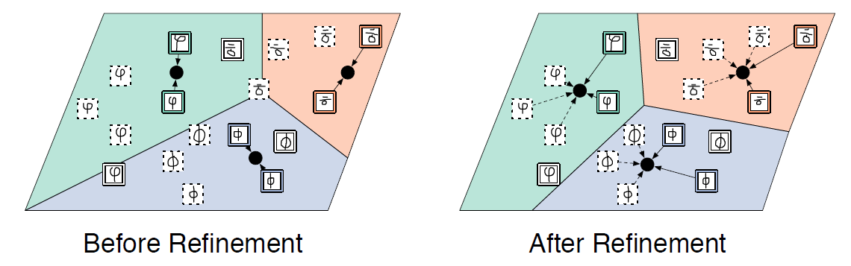
Future Work
Mengye Ren et al. (2018) “Meta-Learning for Semi-Supervised Few-Shot Classification”
Extended this system to take advantage of additional unlabelled data which might be from the test task classes or from other distractor classes. https://arxiv.org/abs/1803.00676

Slide 46
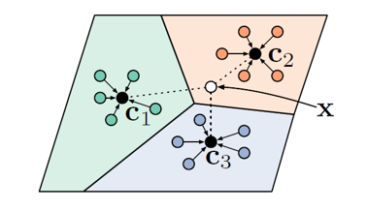
Future Work
Boris Oreshkin et al. (2018) “Task dependent adaptive metric for improved few-shot learning”
Extended this approach by learning a task-dependent metric on the feature space, so that the distance metric changes from place to place in the embedding space. https://arxiv.org/abs/1805.10123

Slide 47
Links & Sources
Prototypical Networks for Few-shot Learning https://arxiv.org/pdf/1703.05175.pdf
GitHub code https://github.com/jakesnell/prototypical-networks
Few-shot learning and meta-learning https://www.borealisai.com/en/blog/tutorial-2-few-shot-learning-and-meta-learning-i/
Advances in few-shot learning https://towardsdatascience.com/advances-in-few-shot-learning-a-guided-tour-36bc10a68b77
Understanding few-shot learning in machine learning https://medium.com/quick-code/understanding-few-shot-learning-in-machine-learning-bede251a0f67
Few-Shot Learning (FSL): What it is & its Applications https://research.aimultiple.com/few-shot-learning/
Understanding Few-Shot Learning in Computer Vision https://neptune.ai/blog/understanding-few-shot-learning-in-computer-vision
N-Shot Learning https://blog.floydhub.com/n-shot-learning/

